Slide 1
Streaming Analytics
Dr. M.John Basha – Mentor
A Rishab Vanigotha - 19BTRCR018
M R Naveen Kumar - 19BTRCR005
Shraddha Hiremath - 19BTRCR037
Sujay Sukumaran Adityan - 19BTRCR051

Slide 2
Objective
Ideal goal of this project is to analyse the real time streaming data using snscrape for data ingestion, Apache Spark to analyse the streaming data using Spark MLlib and Power BI for creating dashboard
Once the data preparation on the fetched data is completed, we will work on sentiment analysis and cyber bullying in this project. In this segment, we will use spark frameworks to analyse data.
Once sentiment analysis and cyberbullying are completed, we will create a graphical user interface (GUI)-based dashboard for better data visualisation, allowing us to gain multiple perspectives on a single piece of data.

Slide 3
Abstract
Organizations may use social media to assess their customers' reactions to material and events in real time. Furthermore, the initial stage of sentiment analysis is the pre-processing of data gathered from social media.
This project covers the use of Twitter in a variety of recommended themes, as it is the largest social networking website, and Twitter data is rising at an increasing pace every day, making it a Big Data Source.
It is becoming more and more clear that the solution to artificial intelligence issues lies in efficient large data analysis. As the amount of data created on a daily basis reaches quintillions of bytes, it is becoming more crucial than ever to have a robust platform for effective big data analytics.
However, using machine learning techniques on large and complex datasets is computationally expensive and uses a lot of logical and physical resources, including CPU, memory, and data file space.
One of the most well-known platforms for big data analysis is Apache Spark MLlib, which provides a number of excellent functionalities.

Slide 4
Literature survey
S.no | Name | Authors | Year of publication | Summary
1 | An Application to Detect Cyberbullying Using Machine Learning and Deep Learning Techniques | Mitushi Raj, Samridhi singh, Kanishka Solanki, Ramani Selvanambi | 2022 | The most accurate network is the CNN-BiLSTM network. While the CNN alone can only train local characteristics from word n-grams, the CNN-BiLSTM can also learn global features and long-term dependencies because to its LSTM layer.
2 | Cyber Bullying Detection on Social Media using Machine Learning | Aditya Desai, Shashank Kalaskar, Omkar Kumbhar, Rashmi Dhumal | 2021 | A semi-supervised approach in detecting cyberbullying based on the five features that can be used. The BERT model achieved 91.90% accuracy when trained over dual cycles which outperformed the traditional machine learning models
3 | Cyber Bullying Detection for Twitter Using ML Classification Algorithms | Muskan Patidar | 2021 | The study evaluated the current literature for several machine learning algorithms and discovered that the Naive bayes N-gram model that results in maximum 67% accuracy
4 | Accurate Cyberbullying Detection and Prevention on Social Media | Andrea Pereraa , Pumudu Fernando | 2020 | In this paper, the author has presented the proposed solution which uses NLP techniques and supervised machine learning to detect cyberbullying accurately. The proposed solution resulted in 74.50% accuracy along with 74% precision, 74% recall and 74% F1 Score.
5 | A Study of Cyberbullying Detection Using Machine Learning Techniques | Saloni Mahesh Kargutkar, Prof. Vidya Chitre | 2020 | The author employed a CNN implementation strategy with Keras in this paper, resulting in noisy labels.

Slide 5
Literature survey
S.no | Name | Authors | Year of publication | Summary
6 | Opinion Mining of Twitter Data using Hadoop and Apache Pig | Anjali Barskar and Ajay Phulre | 2017 | Pig is intended for deep Hadoop analysis and also integrates with the flume is ecosystem for data retrieval and storage in HDFS. We can also detect the polarity of the tweet, which tells us whether the tweet has a positive or negative meaning.
7 | Identifying sarcasm in twitter: a closer look | González-Ibánez, Muresan, & Wacholder Kumar & Bala | 2016 | Tweepy and Twitter4j are used to stream Twitter tweets. Because of some limitations imposed by Twitter on the streaming API, one can only download a certain number of tweets in a particular time window.
8 | Big data emerging technologies: A case study with analyzing twitter data using apache hive | Ennaji, El Fazziki, Sadgal, and Benslimane | 2015 | Hadoop framework for extracting and evaluating customers' opinions about a product from social networks, the provided framework extracts and analyses social customer relationship management opinions
9 | Multi-class tweet categorization using map reduce paradigm | Mohit Tare, Indrajit Gohokar, Jayant Sable, Devendra Paratwar, Rakhi Wajgi | 2014 | To classify the vast quantity of tweets, a Naive Bayes algorithm was applied. Tweets were collected using the Twitter4j library, which leverages the Twitter REST API internally.
10 | Session-based Cyberbullying Detection in Social Media | Peiling Yia, Arkaitz Zubiaga | - | we review existing approaches to cyberbullying detection, with a particular focus on session-based bullying. We examine the Social media Session-based Cyberbullying Detection framework (SSCD)

Slide 6
Existing system
The existing system has three stages: gathering, preprocessing, and modelling.
During the collection phase, multiple techniques like as Tweepy, and Twitter4j are utilized to stream Twitter tweets. These methods are confined to short-term data.
Flume can be used to retrieve long-term data, but the current version is incompatible with the Twitter API.
Working with a single system consumes more computational resources during the preprocessing and modelling phases than working with a cluster.

Slide 7
Proposed system
Our solution is based on the spark. Essentially, our research attempts to gain insights on streaming data using spark.
Based on current trends, we will detect cyberbullying using historical and current tweets.
Spark MLlib is 9x faster than Hadoop Mahout, and other Hadoop disadvantages are solved in Spark, resulting in a 10x - 100x performance improvement over Hadoop.
Our project’s approach is to make the model we design more computationally efficient with the power of spark MLlib.

Slide 8
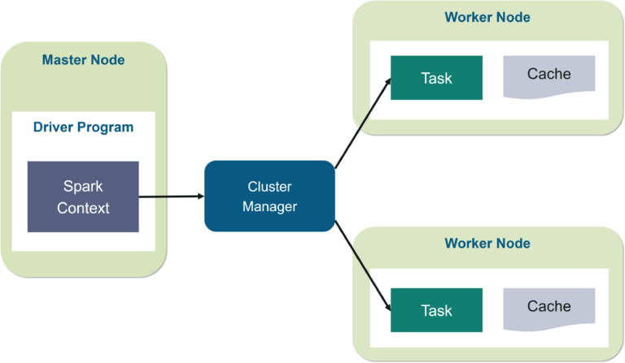
Fig -1
Spark Architecture

Slide 9
Methodology
There are two sections to the proposed methodology –
To train a model for online bullying on the Kaggle dataset and then scrape the tweets for a particular query to identify cyberbullying
Text preprocessing, including the removal of stop words, hashtags, emojis, and punctuation.
Data cleaning comprises deleting missing and duplicate values
Transformation of text to document and feature vectorization includes sentence embedding Training a Deep learning model in SparkNLP using ClassifierDLApproach
Using snscrape, retrieve random tweets from Twitter, determine the trend, then perform sentiment analysis on the trend themes
Using snscrape, fetching the most recent tweets from Twitter and detecting toxic tweets
These tweets are obtained from Twitter using the web scraping tool snscrape.
It collects users, user profiles, hashtags, searches, threads, and list posts and returns the collected information without utilising Twitter's API from social networking services (SNS)

Slide 10
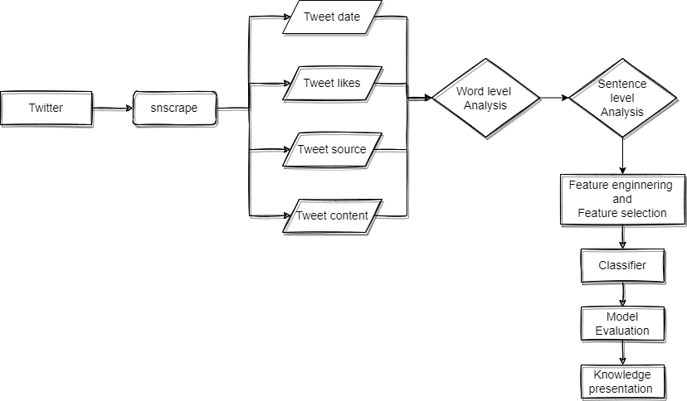
Fig -2
Systematic Diagram

Slide 11
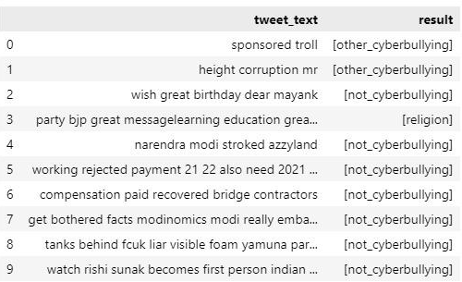
Work done so far
So far, we have obtained a dataset from Kaggle that contains approximately 47000 rows of twitter messages and a cyberbullying type column that contains six different groups - Age, Ethnicity, Gender, Religion, Other cyberbullying, and Not cyberbullying.
Cleaned the dataset by removing duplicates and empty strings
Preprocessed the text data by removing punctuation, hashtags, stopwords, and so on;
Created a pipeline consisting of a series of phases for feature vectorization and sentence embeddings
The pipeline concludes with the ClassifierDLApproach model, which is used to train embeddings from universal sentence encoders.
Achieved 89.3% training accuracy and 84.09% testing accuracy
Fig -3

Slide 12
Software and Hardware requirement
Software Requirements -
Python 3.7 or later
Jupyter notebook or any python IDE
Windows 7 or later
Python libraries - Spark, Pandas, Numpy and Data visualization libraries
GPU Drivers
Hardware Requirements -
Intel i3/i5/i7 or Equivalent AMD processors
Entry level discrete gpu or above (Nvidia MX, GTX, RTX series or Intel iris xe)
4+GB ram
<128GB Storage

Slide 13
References
https://www.ncbi.nlm.nih.gov/pmc/articles/PMC9321314/
https://www.itm-conferences.org/articles/itmconf/pdf/2021/05/itmconf_icacc2021_03038.pdf
https://www.ijraset.com/research-paper/cyber-bullying-detection-for-twitter-using-ml
https://www.sciencedirect.com/science/article/pii/S1877050921002507
https://ieeexplore.ieee.org/abstract/document/9076550
https://aclanthology.org/P11-2102.pdf
https://ieeexplore.ieee.org/abstract/document/7507229/
https://ijcttjournal.org/archives/ijctt-v9p117
https://www.ijcaonline.org/archives/volume158/number9/barskar-2017-ijca-912854.pdf
https://arxiv.org/ftp/arxiv/papers/2207/2207.10639.pdf

